Slide 1
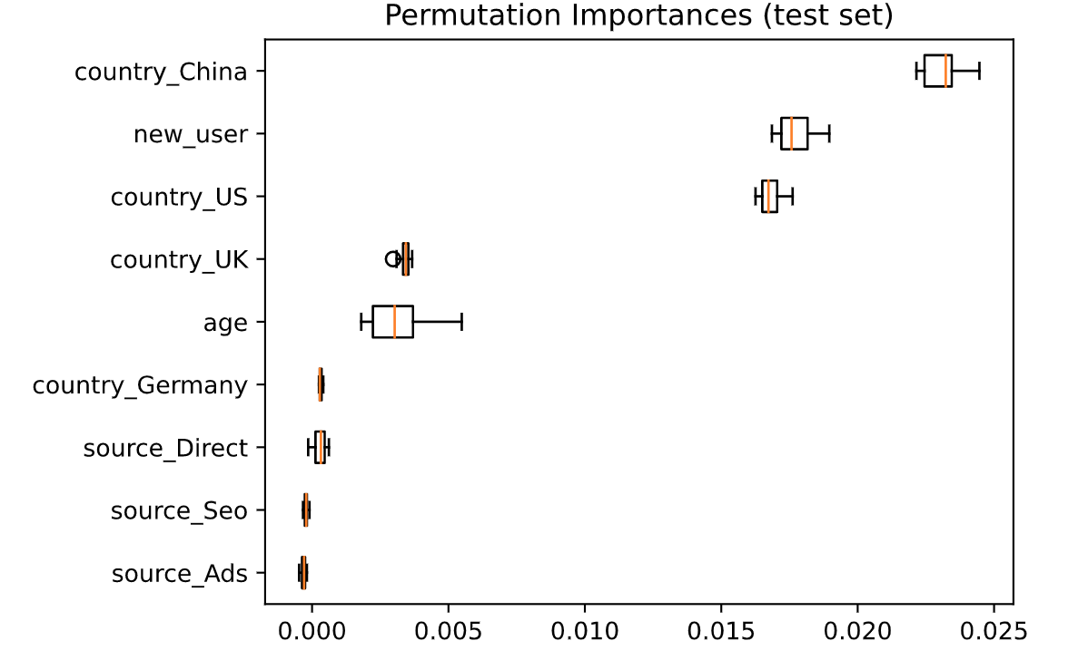
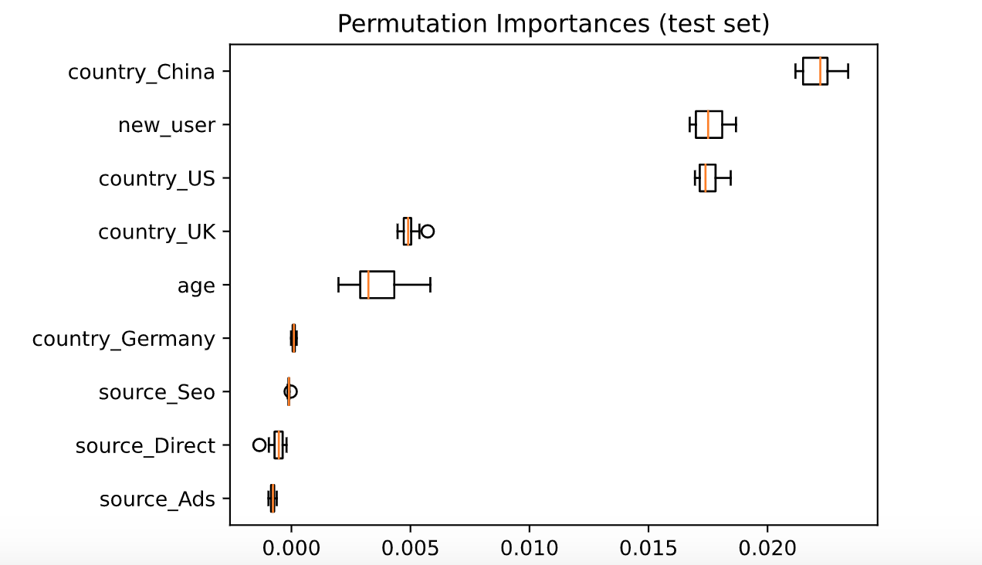
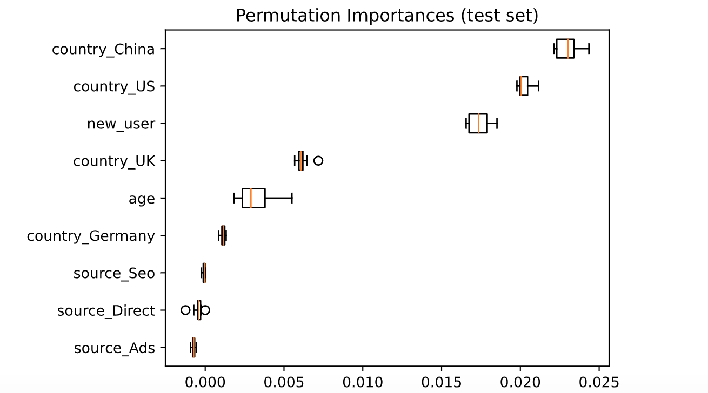
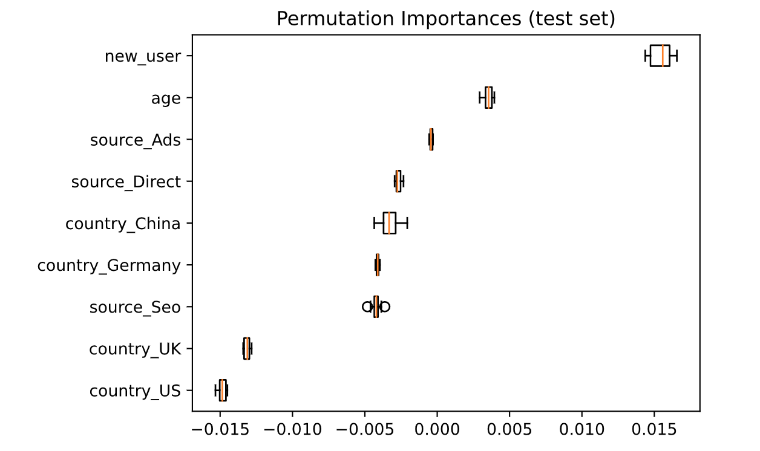
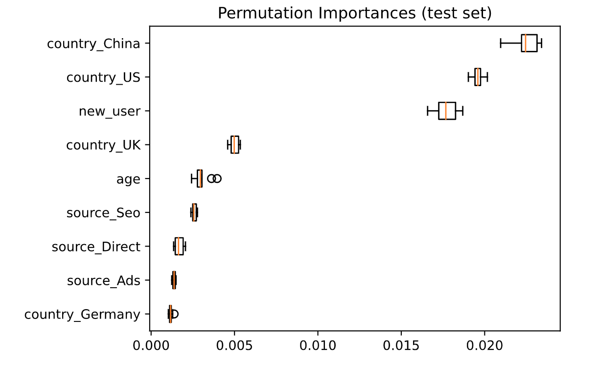
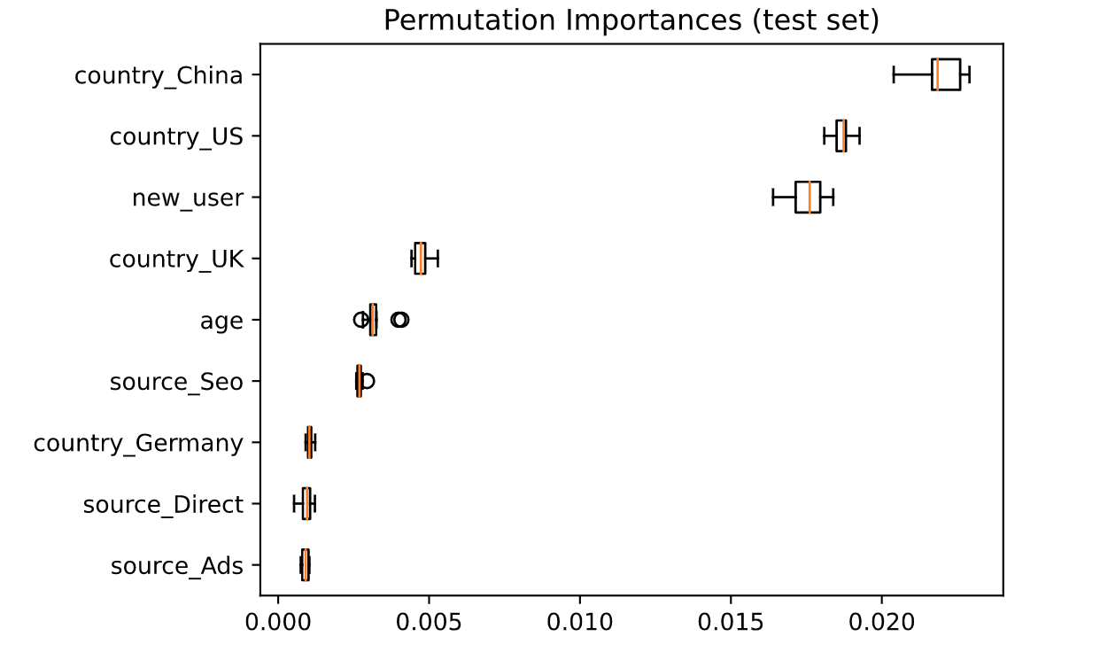
Test
prop
= 20%
20
200
2000
Test
prop
= 33%
2000
20
200
Feature importance is not stable when using a low number of trees.
Notes:
How do the splitting proportion and the number of trees affect the feature importance

Slide 2
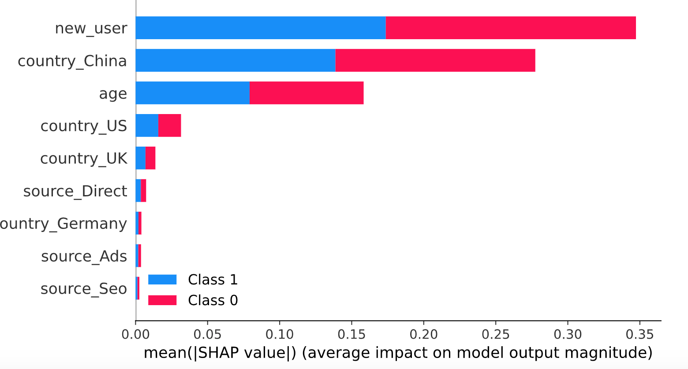
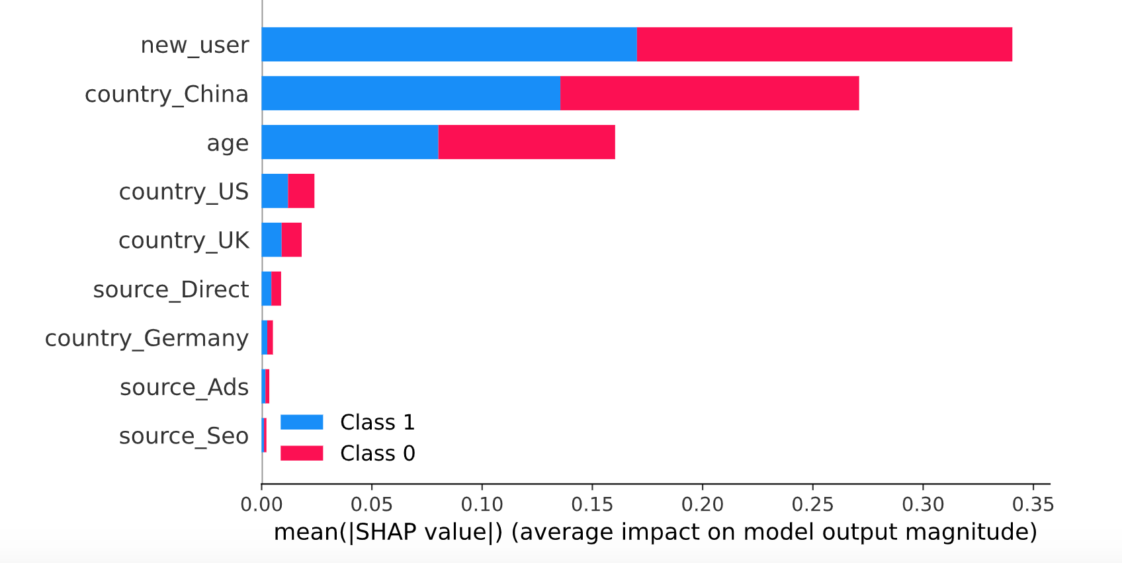
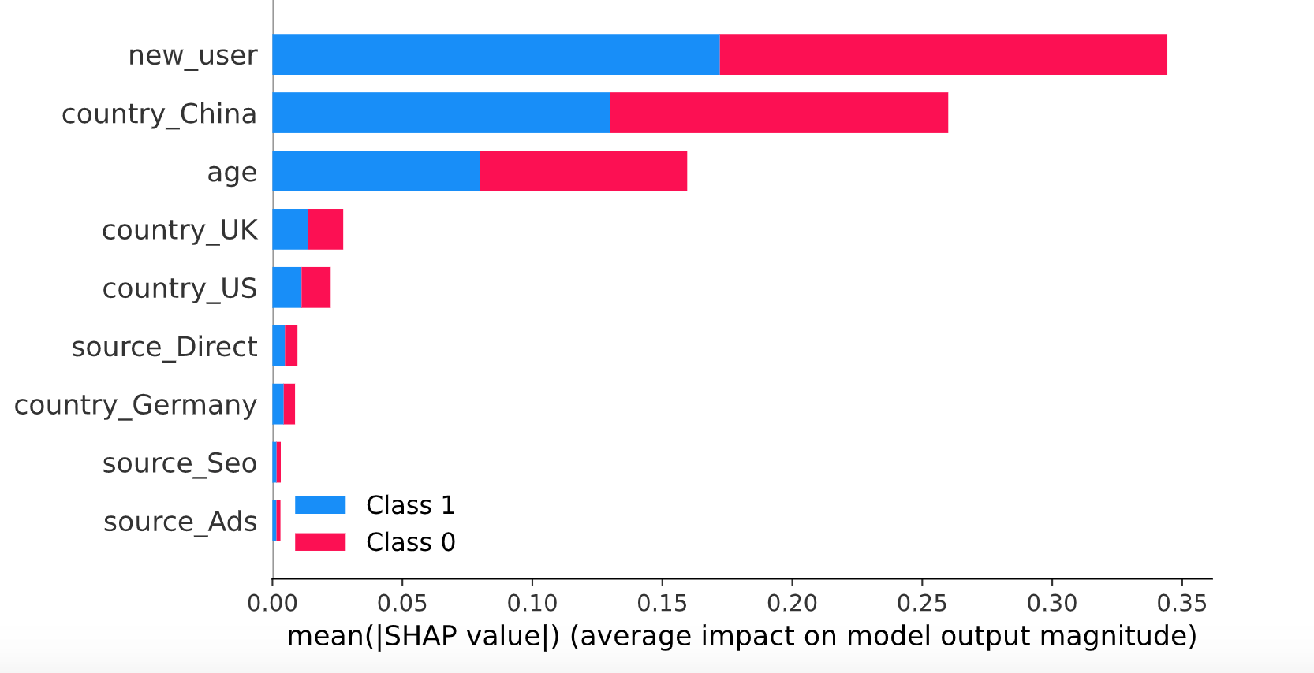
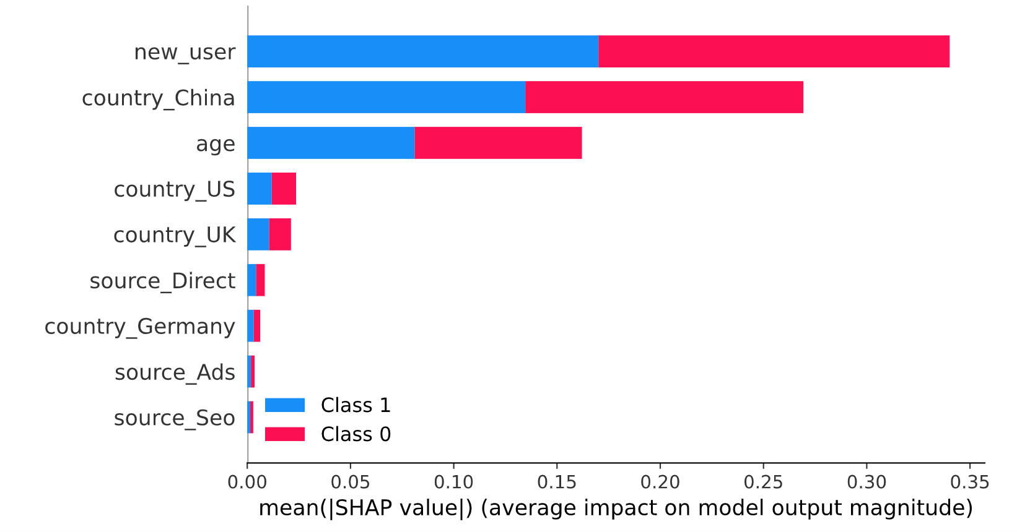
Test prop = 20%
20
200
Test prop = 33%
20
200
Compared with permutation importance, SHAP value is more robust to number of
trees and splitting proportion

Slide 3
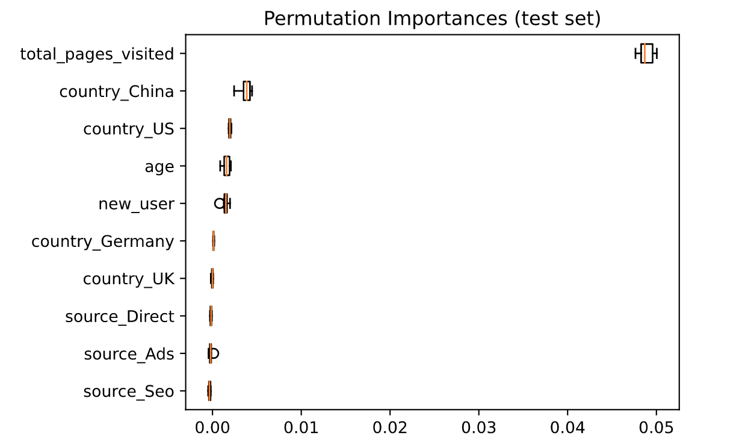
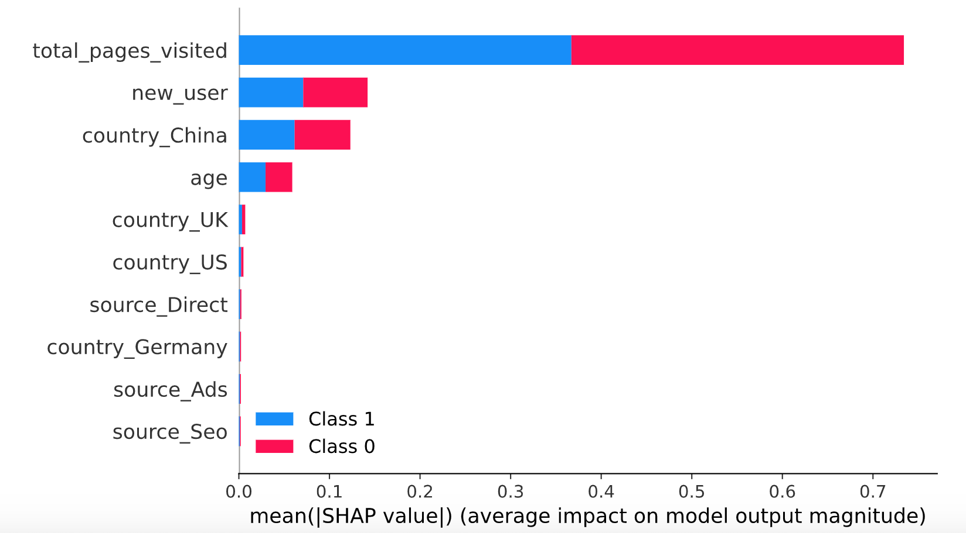
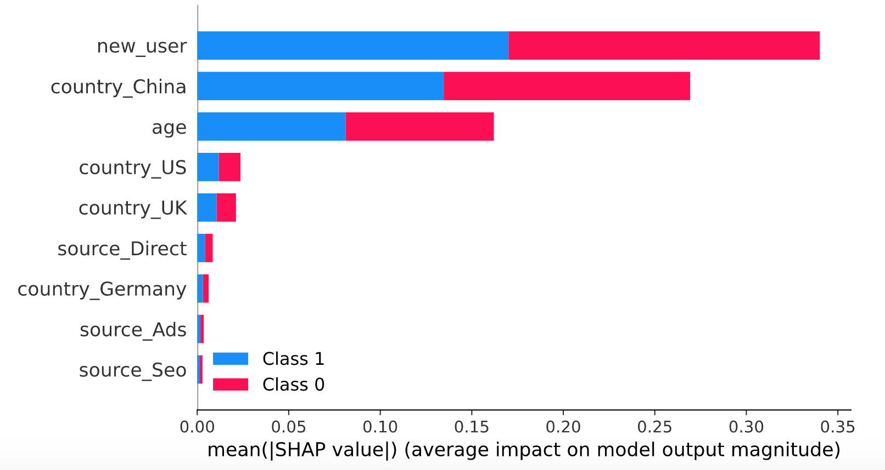
2000 estimator size 0.2 with full features
500 estimator size 0.2 with full features
2000 estimator size 0.2 with total_pages_visited deleted
500 estimator size 0.2 with total_pages_visited_deleted
The relative ranking of features using SHAP is not affected by which features
are included.
Notes:
How does including and excluding a feature affect the feature importance?

Slide 4
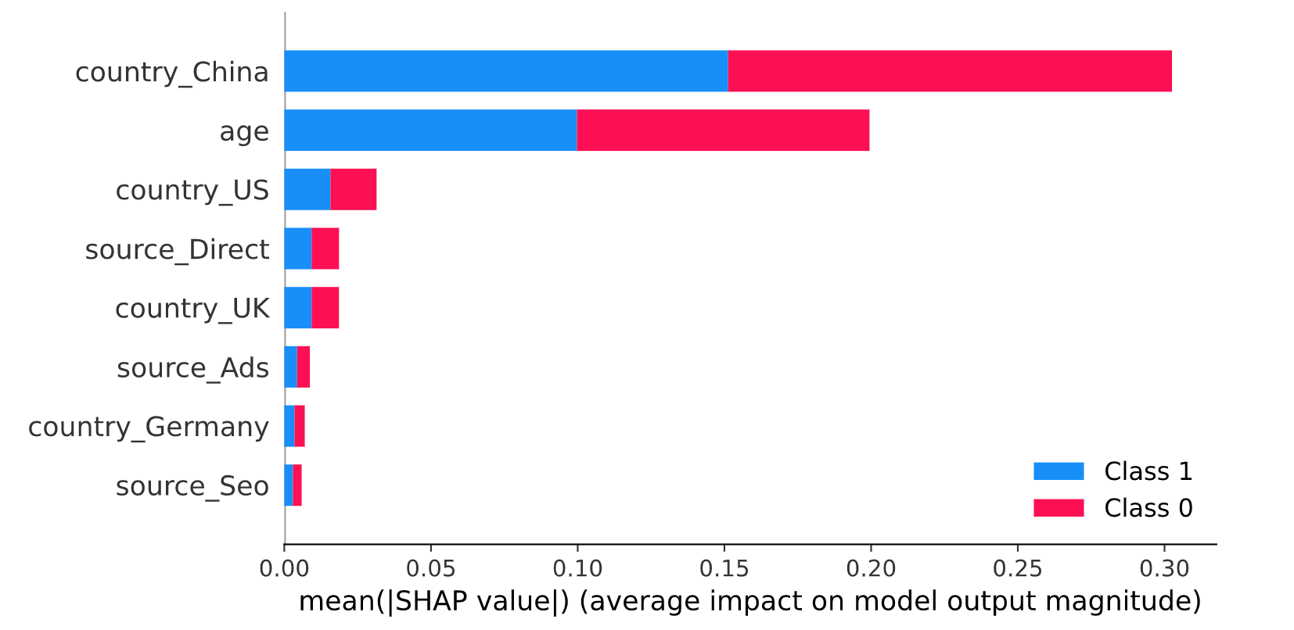
How about excluding more features?
The order stays the same.

